Slide 1
Database and Database Users (2 Hrs)
Introduction; characteristics of the Database Approach, Actors on the scene, Workers behind the scene; Advantages of Using the DBMS Approach

Slide 2
Database
Database is a collection of persistent data, that have some implicit meaning, and is used by the application systems of some given enterprise. A database has the following implicit properties:
  A database represents some aspects of the real world called universe of discourse.
  A database is a logically coherent collection of data with some inherent meaning.
  A database is designed, built and populated with data for a specific purpose.
DB may be generated & maintained manually or it may be computerized.
E.g.:- University database for maintaining information about students, courses and grades in university.

Slide 3
Flat-file Systems
In early processing systems, an organization's information was stored as groups of records in separate files. The file processing systems consisted of a few data files and many application programs. Each file, called a flat file, contained processed information for one specific function, such as accounting or inventory.
A flat file system stores data in a plain text file. Each line of the text file holds one record, with fields separated by delimiters, such as commas or tabs.
A File Management System (FMS) accommodate flat files that have no relation to other files. This type of database is ideal for a simple databases that do not contain a lot of repeated information. Examples include excel spreadsheet or word data list file.
1-<number>

Slide 4
Database Management System
A database is the collection of related persistent data and contains information relevant to an enterprise. The database is also called the repository or container for a collection of data files. For example, university database for maintaining information about students, courses and grades in university.
A database system is basically just a computerized record-keeping system. A database system involves four major components: data, hardware, software, and users.
The database management system (DBMS) is the software that handles all access to the database. It is defined as the collection of interrelated data and a set of programs to access those data.

Slide 5
Database Management System
Users of a DBMS system can perform the following basic operations on the database:
  Adding new, empty files to the database.
  Inserting data into existing files.
  Retrieving data from existing files.
  Changing data in existing files.
  Deleting data from existing files.
  Removing existing files from the database.

Slide 6
Database Applications
Databases form an essential part of almost all enterprises. Some database applications are given below:
  Banking: For customer information, accounts, and loans, and banking transactions.
  Airlines: For reservation and schedule information.
  Universities: For student information, course registrations, and grades.
  Credit card transactions: For purchase on credit cards and generation of monthly statements.
  Telecommunication: For keeping records of call made, generating monthly bills, maintaining balances on prepaid calling cards, and storing information about the communication networks.
  Finance: For storing information about holdings, sales, and purchase of financial instruments such as stocks and bonds.

Slide 7
Database Applications
  Sales: For customer, product, and purchase information.
  Manufacturing: For management of supply chain and for tracking production of items in factories, inventories of items in warehouses/stores, and orders for items.
  Human resources: For information about employees, salaries, payroll taxes and benefits, and for generation of paychecks.

Slide 8
Purpose of DBMS
In early days, database applications were built on top of file systems. These systems have many drawbacks. Database systems offer solutions to all the drawbacks of file systems. The benefits using DBMS are:
  Redundancy can be reduced: The database is said to be redundant if the same information is duplicated in several places (data files). For example, the address and telephone number of a particular customer may appear in a file that consists of saving-account records and in a file that consists of checking-account records. We can reduce redundancy by using DBMS.
  Inconsistency can be avoided: The database is said to be inconsistent if various copies of the same data may no longer agree. For example, a changed customer address may be reflected in saving account but not elsewhere in the system. By using DBMS we can avoid inconsistency.

Slide 9
Purpose of DBMS
  Data can be shared: The data in the database can be shared among many users and applications.
  Transaction support can be provided: A transaction involves several database operations. For example, transfer of a cash amount from account A to account B. In this example two update operations are required.
  Integrity can be maintained: The problem of integrity is the problem of ensuring that the data in database is correct. By using DBMS, we can maintain integrity problems.
  Security can be enforced: Not every user of the database system should be able to access all data.
  Efficient Backup and Recovery can be provided: Provide facilities for recovering from software and hardware failures to reinstate database to previous consistent state.
  Data in the database can be accessed easily.

Slide 10
Database Instances and Schema
The overall structure of the database is called database schema.
The collection of information stored in the database at a particular moment is called an instance of the database.
It is the actual content of the database at a particular point in time.
Database instance changes with every insertion, deletion and update operation performed in data stored in a database.

Slide 11
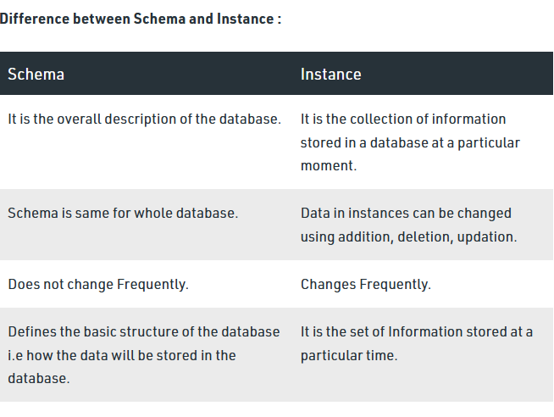

Slide 12
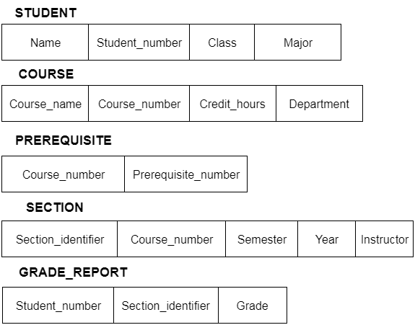
Database Schema

Slide 13
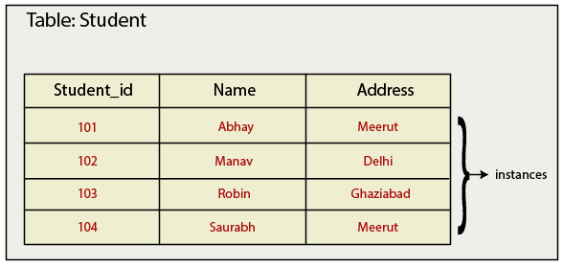
Database Instance

Slide 14
Database Users
Database users can be classified into two categories: actors on the scene and workers behind the scene.
Actors on the Scene:
  These people’s jobs involve develop, use, and administer the database. These people are classified into following categories:
  Database administrators: These people are responsible for authorizing access to the database, for coordinating and monitoring its use, acquiring software and hardware resources, controlling its use and monitoring efficiency of operations. Thus DBA is responsible for the overall control of the system at technical level.

Slide 15
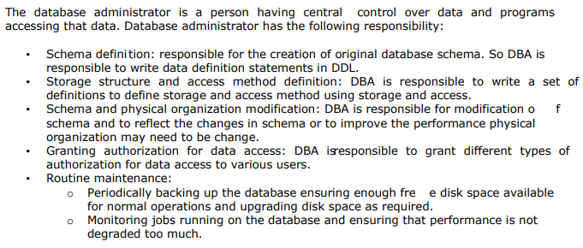
Database Administrator

Slide 16
Database Users
  Database Designers: These people are responsible for defining the content, the structure, the constraints, and functions or transactions against the database. They must communicate with the end-users and understand their needs.
  End Users: They use the database for querying, updating and generating reports. End-users can be categorized as follows:
    Casual end users: They access database occasionally when needed. They use sophisticated database query language. They are middle or high-level managers.
    Naive or Parametric end users: They make up a large section of the end-user population. They use previously well-defined functions in the form of “canned transactions” against the database. For example, bank-tellers, reservation clerks.

Slide 17
Database Users
    Sophisticated end users: They have clear knowledge of database system facilities to construct complex queries. They are Engineers, Scientists. They make use of most database facilities.
    Stand-alone: They make use of personal databases by using ready-made program packages that provide easy-to-use menu based interface.
  System Analysts and Application Programmers:
    System analysts determine the requirements of end users, especially naive or parametric end users and develop specifications for canned transactions that meet these requirements.
    Application programmers implement these specifications as programs; then they test, debug, document and maintain these canned transactions.

Slide 18
Database Users
Workers Behind the Scene:
  These people are associated with the design, development, and operation of the DBMS software and system environment. These people are not actively interested in the database itself. These people are classified into following types:
  DBMS System Designers and implementers: These people design and implement the DBMS modules and interfaces as a software package.

Slide 19
Database Users
  Tool developers include persons who design and implement tools—the software packages that facilitate database system design and use, and help improve performance. Tools are optional packages that are often purchased separately. They include packages for database design, performance monitoring, natural language or graphical interfaces, prototyping, simulation, and test data generation. In many cases, independent software vendors develop and market these tools.
  Operators and Maintenance Personnel: These personnel are responsible for the actual running and maintenance of the hardware and software environment for the database system.

Slide 20
Advantages and Disadvantages of DBMS
Advantages of DBMS
Data Independence : DBMS provides abstract view of data. Application programs are independent from details of data representation and storage.
Data Integrity and Security: DBMS allow to enforce integrity constraints on data. For example before inserting salary information for an employee, DBMS can enforce integrity constraint to check salary is not exceeded department budget

Slide 21
Advantages of DBMS
Data Administration: DBMS provides centralized administration of data. It is appropriate when several no of database users share data. It improves the overall performance of database system
Concurrency Control and Crash Recovery : DBMS has a capability to manage concurrent access. It schedules concurrent access to the data in such a manner that all users fell data is being accessed by only one user at a time. Moreover, DBMS protects users from the effects of system failures.

Slide 22
Advantages of DBMS
Reduced application development time: Since DBMS supports many important functions that are common to many applications accessing data stored in database. It provides high level interface to data and facilitates quick development of applications.
Providing multiple User interfaces : Because many types of users with varying levels of technical knowledge use database, a DBMS should provide a variety of user interfaces. These include query languages for casual users, programming language interface for application programmers. Forms and command codes for parametric users and menu driven interfaces and natural languages for stand along users

Slide 23
Advantages of DBMS
Representing Complex Relationships Among Data :
A database may include numbers varieties of data that are interrelated in many ways.
A DBMS must have the capability to represent a variety of complex relationships among the data as well as to retrieve and update related data easily and efficiently.
Enforcing Integrity Constraints: Most database applications have certain integrity constraints that must hold for the data. A DBMS should provide capabilities for defining and enforcing these constraints. The simplest type of integrity constraint involves specifying a data type for each data item.

Slide 24
Advantages of DBMS
Providing Backup and Recovery: A DBMS must provide facilities for recovering from hardware or software failures. The backup and recovery subsystem of the DBMS is responsible for recovery.
For example, if the computer system fails in the middle of a complex update program, the recovery subsystem is responsible for making sure that the database is restored to the state it was in before the program started executing. Alternatively, the recovery subsystem could ensure that the program is resumed from the point at which it was interrupted so that its full effect is recorded in the database.

Slide 25
Disadvantages of DBMS
Complex architecture of DBMS software.
DBMS software cost is expensive
Slow in answering complex queries.
Technical manpower is required which is expensive in most of the cases.

Slide 26
TU Old Questions
What are different types of Database Users and their roles? Explain the Data Independence with example[10] -2078
What are the advantages of using Database management System over traditional filing system? Explain different data models with examples[ 3+7] -076
Who is database administrator? What are the main function of database administrator ? [5]-075
Why do we need database management system? Discuss drawbacks of file system and advantages of database management system. [2+3]

Slide 27
TU Old Questions
5. What is database management system? Discuss the advantages of using database management system over file system [2+3=5].

